Slide 1
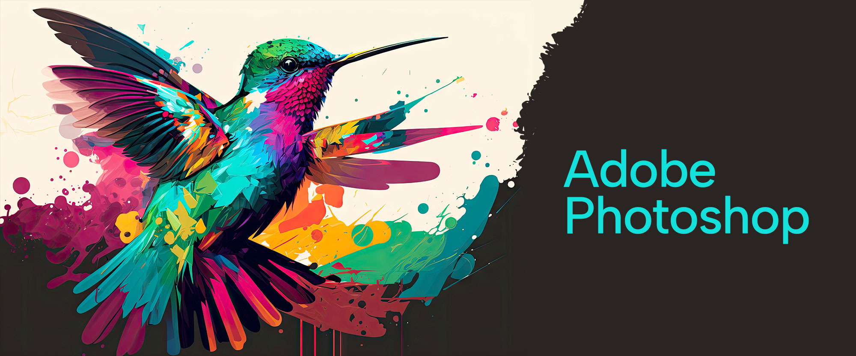

Slide 2
About today…
Double exposure

Slide 3
Introduction to Double Exposures
Definition
Double exposure is a creative photographic technique that involves combining two different images into a single frame, creating a surreal or symbolic effect
History
Originated in film photography, where two exposures are made on the same film to merge images
Modern Usage
Now commonly achieved through digital editing in software like Photoshop, offering more control and precision
Purpose
Used for artistic expression, storytelling, or creating visually compelling imagery

Slide 4
Setting Up for Double Exposure
Choosing Your Images
Base Image
Start with a clear, high-contrast portrait or silhouette
Secondary Image
Select an image with strong shapes or patterns, like a landscape, cityscape, or texture
Preparing Your Images
Adjust Lighting
Ensure both images have compatible lighting for a seamless blend
High Contrast
Increase contrast in the base image to make the blending effect more pronounced
Remove Background
Use selection tools to remove the background of the portrait if necessary

Slide 5
Creating a Double Exposure in Photoshop
Step 1
Open both images in Photoshop
Step 2
Place the secondary image above the base image in the Layers panel
Step 3
Change the Blending Mode of the secondary image layer to Screen or Lighten to merge it with the base image
Step 4
Use Layer Masks to refine the blending, revealing or hiding parts of the images as needed
Step 5
Adjust Opacity and Levels for better integration of the two images
Step 6
Fine-tune colors and contrast using Adjustment Layers

Slide 6
Enhancing Your Double Exposure
Gradient Maps
Use gradient maps to unify the color tones across both images for a cohesive look
Textures and Overlays
Add textures or light leaks to enhance the artistic feel of the double exposure
Dodging and Burning
Lighten or darken specific areas to add depth and direct focus within the image
Fine-Tuning Edges
Use soft brushes on the layer mask to smooth transitions between the images
Final Adjustments
Apply final color grading or filters to harmonize the image as a whole

Slide 7
Creative Variations of Double Exposures
Multiple Exposures
Experiment with more than two images for a complex, layered effect
Color Overlays
Apply color overlays to different areas of the image for an abstract look
Symmetrical Double Exposure
Create symmetry by duplicating and flipping the secondary image
Incorporating Text
Merge text elements with the double exposure for a conceptual design
Double Exposure Portraits
Focus on blending human features with natural elements like trees or water

Slide 8
Common Mistakes and Tips
Common Mistakes
Overcomplicating
Adding too many images or effects can clutter the composition
Ignoring Lighting Consistency
Mismatched lighting between images can break the illusion
Poor Alignment
Misaligned images may result in a disjointed look
Tips for Effective Double Exposures
Start Simple
Begin with two well-matched images to master the basics before experimenting
Focus on Composition
Ensure the images complement each other and enhance the overall story
Use High-Resolution Images
High-quality images ensure a clean, professional finish

Slide 9
Practice Exercise
Objective
Create a double exposure using a portrait and a landscape
Steps
Select a portrait as your base image
Choose a landscape with strong features (e.g., mountains, trees)
Follow the steps learned to blend the images
Experiment with blending modes and masks
Add finishing touches with gradient maps and textures

